Slide 1
Normal form of matrix
By Dr. Niharika Kulshrestha
CDA-102

Slide 2
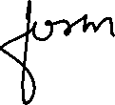




































Slide 3


















Slide 4


















Slide 5




















Slide 6

















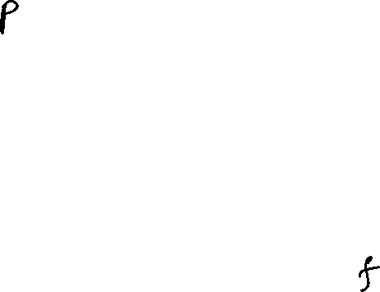




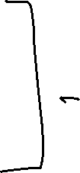


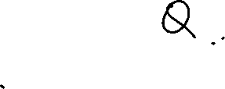









Slide 7






